Slide 1

OnvifSense
PROJECT SEMINAR
B.E. SEMESTER II
SMT. KASHIBAI NAVALE COLLEGE OF ENGINEERING,PUNE

Slide 2

OnvifSense
GUIDED BY
PROF. S.P.PINGAT
PROF. S.V.DABHADE
SPONSORED BY
PERSISTENT SYSTEMS
PRESENTED BY:
YOGIRAJ AWATI
RAHUL GUTAL
SAURABH TAWARE
ABHIJEET BHINTADE

Slide 3
PROBLEM STATEMENT
To provide a mechanism by devising a GUI application that facilitates interoperability between several network devices of different vendors and discovery of network devices implementing target services.

Slide 4
ABOUT ONVIF
Open Network Video Interface Forum (ONVIF) is an open industry forum which was established in 2008 by Axis Communications, Bosch Security Systems, and Sony Corporation.
It is committed to standardize communication between network devices to ensure interoperability between network products for the security market.

Slide 5
OBJECTIVES
To provide common base for fully interoperable network implementation.
Combine management of clients and network devices.
Maintaining history of clients and devices that implement target services.
Maintaining capabilities and attributes of network devices.
A simple framework that clearly defines management of clients and network devices
Open source product that can be further improved.

Slide 6
SCOPE
To decrease the complexity and increase efficiency of variety of tasks and make them easier to express and run.
These include:
•Administrator tasks.
•Multi-User tasks.
•Complex activities by discovering devices in network.
•Authenticating tasks.

Slide 7
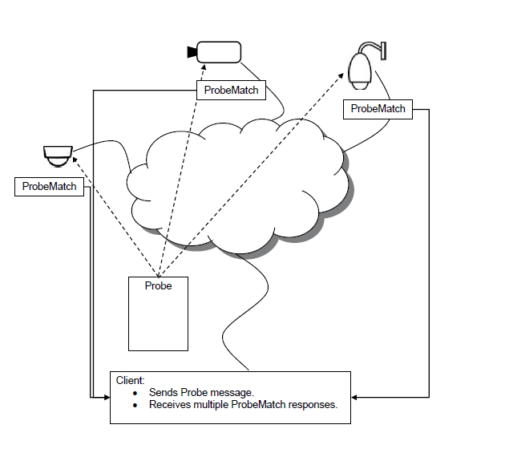
SYSTEM OVERVIEW

Slide 8
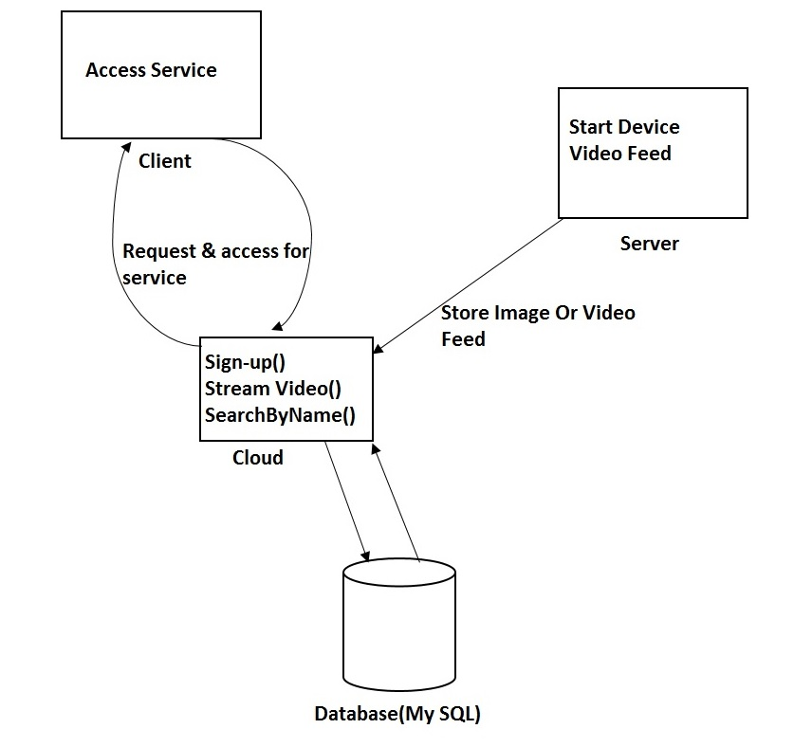
SYSTEM ARCHITECTURE

Slide 9
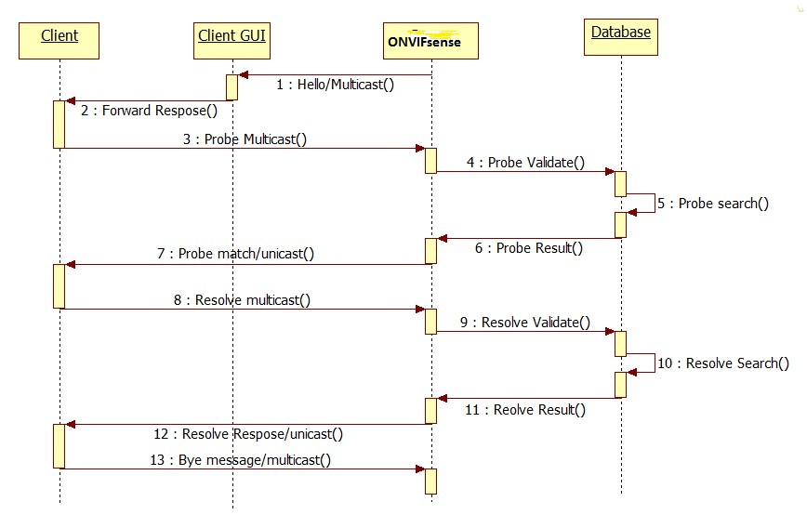
System’s Sequence Diagram

Slide 10
Modes of Communication
3 Important Types of Messages for Communication-
1. ONVIF::DiscoverySendProbe
This function composes and sends a WS-Discovery Probe for the specified scopes and types.
2. ONVIF::DiscoveryReadResponse
This function reads and processes responses to Probe messages, then updates probematcheslist.
3. ONVIF::ProcessMatch
When processing the list of discovered devices, the probes are matched.

Slide 11
Modes Of Operation
The device shall be able to operate in two modes:
• Discoverable (sends HELLO multicast and listens to reponses)
• Non-discoverable (does not send HELLO and is inactive)

Slide 12
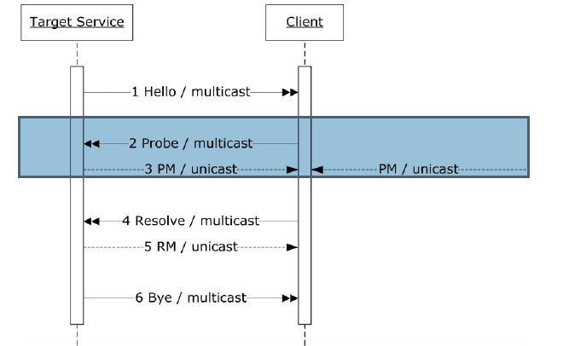
INTERNAL WORKING

Slide 13
Algorithms
Discovery algorithm
Initialize list to null , list will contain probematches for a particular probe that is being sent.
Send the probe containing scopes and types for the target service on multicast address and port.
Wait for the responses for a particular period of time
Now read the response for a particular probe , if response is not present already in the list, then add it otherwise ignore it
Process each probematch present in the list.

Slide 14
Pseudo code for Discovery
// Send WS-Discovery Probe, collect the responses and then process the responses.
probematch_type probematcheslist[]={};
probe = ONVIF::DiscoverySendProbe(scopes, types); // Send probe.
while (data_available_and_not_timeout(probe.net_handle)) // Wait a while for responses
{
// This fetch next probe match so that we can put it into the list
probematch = ONVIF::DiscoveryReadResponse(probe); // Store info about the match, first check for duplicates
if (!in_list(probematcheslist, probematch))
{
add_to_list(probematcheslist, probematch);
}
foreach (probeMatch in probematcheslist) //// Process the responses.
{
ONVIF::ProcessMatch(probeMatch);
}

Slide 15
Algorithm for Send Probe
1. Build probe message
3. Provide Types and Scopes.
4.invoke
5.Return probe

Slide 16
Pseudo code for SendProbe
DiscoverySendProbe(scopes, types)
{
// Each probe should have a unique MessageID to be able to match
// requests and responses. We store it in the probe place holder for later checking
probe.MessageID = "uuid:" + App.uuidGenerate();
// Build probe message, we provide MessageID, Types and Scopes.
message = App.BuildProbeMessage(probe.MessageID, types, scopes);
// Send probe to multicast address and port .
probe.net_handle = App.send_multicast("239.255.255.250", 3702, message);
return probe;
}

Slide 17
Algorithm for ReadResponse
1.To update the Probematchlist which consists of responses matched to our probe messages we need the both body and header of the of response to process on it.
2.Check if it is response to the probe that we sent.
3.If it matches we update Probematchlist and pick up one of response from probematchlist to process.
4.Get the Xaddress which is space seperated list of URLs to device service.
5.Return Probematch.

Slide 18
Pseudo code for ReadResponse
DiscoveryReadResponse(probe)
{
// Read response and process it. We need both the body and the Header:
aProbeMatches = App.ReadProbeMatches(probe.net_handle, Header);
if (Header.RelatesTo != probe.MessageID) // Check if this is a response to the probe we sent:
return -1;
// We pick what we need from the response:
probematch.types = aProbeMatches.ProbeMatch.Types;
probematch.scopes = aProbeMatches.ProbeMatch.Scopes;
// XAddrs is a space separated list of URLs to the Device service:
probematch.xaddrs = aProbeMatches.ProbeMatch.XAddrs;
probematch.metadataversion = aProbeMatches.ProbeMatch.MetadataVersion;
probematch.address = aProbeMatches.ProbeMatch.EndpointReference.Address;
return probematch;
}

Slide 19
SOFTWARE AND HARDWARE SPECIFICATION
HARDWARE REQUIREMENTS:
Process/RAM/HDD : 800 MHz, 128MB, 256MB
Windows XP SP3 operation system (or higher; Windows 7 recommended)
Microsoft .NET Framework 4
1 Gb RAM (2 Gb recommended)
Database Server : SQLite Database System
2. SOFTWARE SPECIFICATION:
OS : Windows 7.
Front End/Back End : Visual Studio 2012
Open-Source Repository : GSOAP Library

Slide 20
TEST CASES
TEST CASE 1:
PRECONDITION: Device is in discoverable mode
ACTION: Send request to system for the device
POSTCONDITION: Device responds to the system request
TEST CASE 2:
PRECONDITION: Device is in non discoverable mode
ACTION: Send request to system for the device
POSTCONDITION: System displays non discoverable status of device

Slide 21
ADVANTAGES
To minimize the need for polling, target services that wish to be discovered send an announcement.
Define specification for a multicast discovery protocol to locate services.
Provides the common base for a fully interoperable network implementation comprised of products from different network vendors.
The standard reuses existing relevant standards where available, and introduces new specifications only where necessary.

Slide 22
APPLICATIONS
Domestic Security purpose
For performing Interoperability between various devices all over the globe.
Video surveillance and monitoring

Slide 23
REFRENCES
‘ ONVIF-Core-Specification-v240 ’ whitepaper by onvif consortium.
‘ ws-discovery ’ whitepaper by Microsoft Corporation.
‘ WorkshopForSEC_presentation ’ whitepaper by Axis Communications.
‘ ONVIF_Recording_Control_Test_Specification_v1306 ’ whitepaper by onvif consortium.
‘ ONVIF_Feature_Discovery_Specification_v1306_2 ’ whitepaper by onvif consortium.
‘ ONVIF_Profile_C_Specification_RC ’ whitepaper by onvif consortium
Sean J. Barbeau, Miguel A. Labrador, Philip L. Winters, Rafael Pérez,NevineLabibGeorggi, “Distributed Multimedia Content Processing in ONVIF Surveillance System”, IEEE Communications Magazine November 2006

